Slide 1

Procurement Timing Improvement Value Stream Mapping Project
19-December-2023
Blue Font = Updates from Todays meeting

Slide 2
AvionX Lean Value Stream Mapping Project: AvionX Procurement Flow Time
Scope: Lab / Production Procurement (Government) Build to Print Parts
Workstreams: Developing Requirement (Need to Procure)
Creating the Buy Package
Soliciting Buy Package
Supplier Selection
Procurement Documentation
Contract Placement
BDS & BR&T
Project 2
Project 1
Goal: Develop Lean process & standard timing for COTS, Non COTS Lab & Production Procurement Flows
Deliverables: Develop a consistent, predictable, repeatable, clearly defined process with optimized timing
Identify current state
Identify waste / improvement opportunities
Create a future state map & plan to implement required improvements
Creating aligned standard timing & inputs for Procurement activities
Team: Brandon Ady Tracy Compton Caitlin Fitzgerald Laura Piontek
Param Krishnan Noah Mass Jeff McElfresh Amy Hensley
Isaac Rosabal Kelly Weiser

Slide 3
Project 2 – AvionX COTS Lab Parts:
Identify any key stakeholders that should be involved in the process development
Quick Run through of Project 1 process flow
Update Project 1 baseline to reflect revised scope of work
Identify new opportunities
Assign opportunities to team members
Work to implement opportunities into processes and process guidance (Command Media, etc)

Slide 4
VSM Map Future State:
DRAFT
PROJECT 2
(Starting with Project 1 Process Map)
Eng & SM
Together
Develop Parts List
Identify Hazardous or EEE Parts
Look at developing a template
Proprietary
Info
Confirm Chargelines Are Active (Finance)
Populate New
New Request Template
Obtain Chargelines (Material & Labor)
Conduct Kickoff Meeting
Obtain list of potential suppliers (if required)
Populate Requirements Justifcation Form (Eparts) or CAPRS Req Form
Enter order into E-Parts / CAPRS
Engineering Management Signoff
Property Management Signoff
Transfer
Time: 0
Transfer
Time: 0
Transfer
Time:
0
Transfer
Time: 0
Transfer
Time:
0
Task Time:
Total Duration:
1 Hour
1 Day
1 Hour
1 Day
2 Hours
1 Day
2 Hour
1 Day
1 Hour
1 Day
10 Minutes
0-1 Day
10 Minutes
0-1 Day
Estimates are ROM
PA
SBM
Eng
Finance
Prog Mgr
Other
P
P
P
P
P
P
P
P
E-Parts Focal
P
SRE

Slide 5
VSM Map Future State:
DRAFT
Have a signoff event
PROJECT 2
Pull PR from NWP Queue (CAPRS)
Other CAPRS Signoffs
Prog Mgr
Quality (Standardize via RSI & Commodity CodesIn)
Buyer
Planner
Non-Competitive Approval
30-39 Work Days Minimum
Questions from supplier may add time
23 Work Days Minimum
Finance Signoff
MMO Team Review (EPARTS/CAPRS as req)
Assign PR to a Purchasing Tower (EPARTS)
Buyer to Pull Order into their Queue (EPARTS)
Bidder Board Approval
RFP Release
Proposal Received
Eng Finance Proposal Eval Complete
Transfer
Time
Transfer
Time
Transfer
Time
Transfer
Time
Transfer
Time
Transfer
Time
Transfer
Time
Transfer
Time
Task Time:
Total Duration:
10 Minutes
1 Day
TBD
1 Day
TBD
1 Day
TBD
1 Day – 2 Days
TBD
2
TBD
2
TBD
10 – 15 Days
TBD
5
PA
SBM
Eng
Finance
Prog Mgr
Other
P
P
P
P
P
P
P
P
Supplier
SRE
Materials Mgt Org

Slide 6
VSM Map Future State: Non COTS Lab Procurements
DRAFT
PROJECT 2
Bypass if Non-TINA
And/or if Non Govt & < $2M
17-(32+N) Work Days Minimum
Supplier Down-select
Negotiat-ions Complete
Document Procure-ment Decision
Peer Review
Manager Review
Systems Integrity Review & Approval
Contract Award / PO Release
Supplier acknow-ledges PO in their System
Transfer
Time
Transfer
Time
Transfer
Time
Transfer
Time
Transfer
Time
Transfer
Time
Transfer
Time
Transfer
Time
Task Time:
Total Duration:
TBD
2
TBD
5 – N Days
TBD
1 – 5 Days
TBD
1 – 2 Days
TBD
1 – 2 Days
TBD
5 – 10 Days
TBD
1
TBD
1 – 5 Days
How could we do this faster?
PA
SBM
Eng
Finance
Prog Mgr
Other
P
P
P
P
P
P
Supplier
Risk
Management
P
Supplier
P
SRE

Slide 7
Project 1

Slide 8
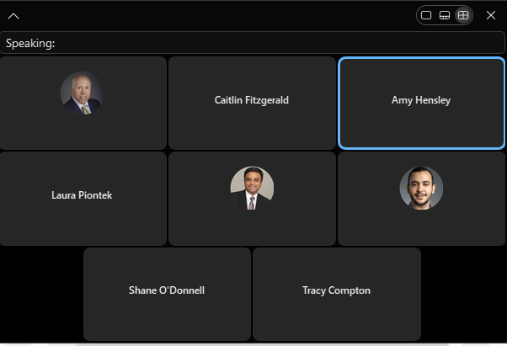
12/19/23 – Meeting Attendees

Slide 9
Project 1 – BR&T Non-COTS Lab Parts - Open Items:
Identify Leads for Each Identified Opportunity
Work Identified Opportunities to Achieve improvement
Incorporate improvements into Timeline
Incorporate improvements into necessary process guidance / command media / AvionX Process Library

Slide 10
Opportunity Space
NEED TO ASSIGN TASKS TO PEOPLE TO PURSUE / ACHIEVE INTO NEW STANDARD WORK
Opportunities:
Hold a kickoff meeting to set expectations & inform all stakeholders.
Create standard Kickoff Agenda
Populate a template instead of many notes / IMs back and forth
Create the template
If we had a place to see status, showed all the steps it would cut down on e-mails (They are working on a Where’s my stuff dashboard)
Early Involvement for Long Lead Parts or Difficult to Procure Parts (During BTP Creation): Communicate to Procurement / Evaluate with Suppliers & feedback information to Engineering
Communicate the OVERALL process & timing to stakeholders early
Notify Suppliers that a PIA is being Developed
Develop & Maintain a list of Approved Suppliers by Commodity Code
Shorten the RBPI Intellectual Property Review Process from 14 days (Corporate Process / Low Likelihood) – Follow up with RBPI team
Investigate Streamlining E-Parts Approval Process – as most orders are approved. (automated depending on thresholds)
Require having delegate approvers for vacations in E-Parts
Shorten the Supplier response to PIA time to a standard 5 days.
Systems Integrity Review & Approval – Opportunity to bypass in some circumstances
Release of RBPI – Shorten from 15 days to 3 – Work with Corporate teams
Engineering & Supplier Management to Collaborate on the BOM. Eng / PM needs to get SM engaged early.
Generate Lists of Potential Suppliers Faster (than 5 days)
Accelerate RBPI Review of Supplier Responses (set up dialogue with RBPI Team)
Inform Eng Finance at time of RFP Release that the Proposal will be coming back shortly
Identify candidate program to work through the process / changes with – HOLD ABOVE UNTIL WE HAVE PROGAM IDENTIFIED
Requirements Justification form – Create template (currently no standard)
Location to house approved Requirements Justification Forms to scan through to see if an approved form already exists
Any Steps that can be deleted / automated / done in parallel:
Blue Font = Updates from Today

Slide 11
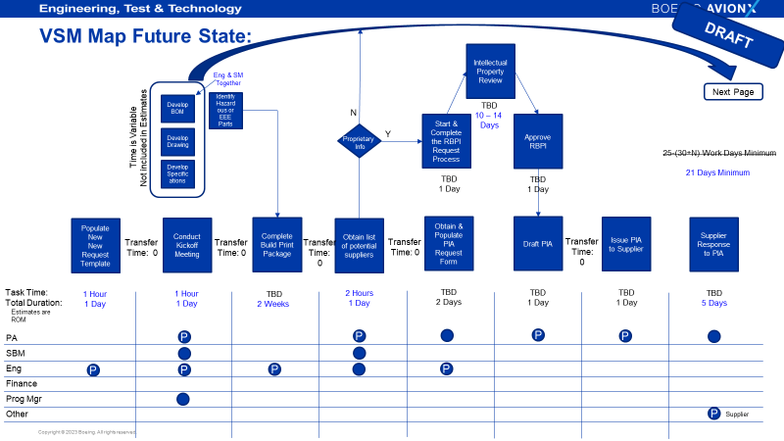
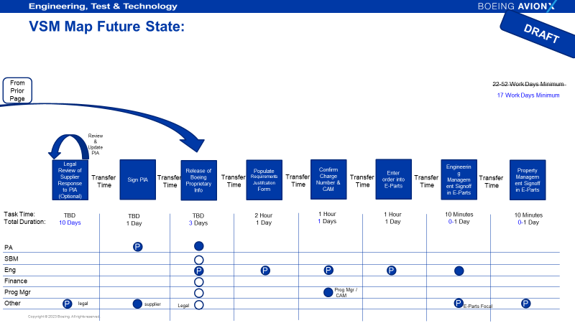
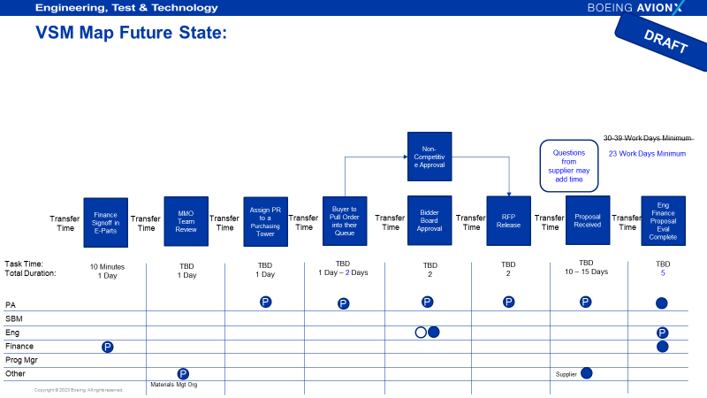
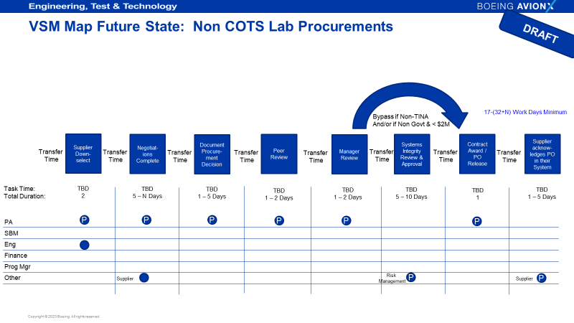
Future State Map
32+ Process Steps
94 78 Working Days – 153 TBD
5.5 4.5 Months Elapsed Timing

Slide 12
VSM Map Future State:
DRAFT
Intellectual Property Review
Eng & SM
Together
Next Page
Develop BOM
Identify Hazardous or EEE Parts
TBD
10 – 14
Days
N
Start & Complete the RBPI Request Process
Approve RBPI
Time is Variable
Not included in Estimates
Y
Develop Drawing
Proprietary
Info
25-(30+N) Work Days Minimum
21 Days Minimum
Develop Specifications
TBD
1 Day
TBD
1 Day
Look at doing in parallel
Populate New
New Request Template
Conduct Kickoff Meeting
Complete Build Print Package
Obtain list of potential suppliers
Obtain & Populate PIA Request Form
Draft PIA
Issue PIA to Supplier
Supplier Response to PIA
Transfer
Time: 0
Transfer
Time: 0
Transfer
Time:
0
Transfer
Time: 0
Transfer
Time:
0
Draft in parallel with RBPI and complete at same time
Task Time:
Total Duration:
1 Hour
1 Day
1 Hour
1 Day
TBD
2 Weeks
2 Hours
1 Day
TBD
2 Days
TBD
1 Day
TBD
1 Day
TBD
5 Days
Estimates are ROM
PA
SBM
Eng
Finance
Prog Mgr
Other
P
P
P
P
P
P
P
P
P
Supplier

Slide 13
VSM Map Future State:
DRAFT
From Prior Page
22-52 Work Days Minimum
17 Work Days Minimum
Look at pulling earlier
Look at pulling earlier
Do after signed PIA
Review & Update PIA
Legal Review of Supplier Response to PIA (Optional)
Sign PIA
Release of Boeing Proprietary Info
Populate Requirements Justifcation Form
Confirm Charge Number & CAM
Enter order into E-Parts / CAPRS
Engineering Management Signoff
Property Management Signoff
Transfer
Time
Transfer
Time
Transfer
Time
Transfer
Time
Transfer
Time
Transfer
Time
Transfer
Time
Task Time:
Total Duration:
TBD
10 Days
TBD
1 Day
TBD
3 Days
2 Hour
1 Day
1 Hour
1 Days
1 Hour
1 Day
10 Minutes
0-1 Day
10 Minutes
0-1 Day
PA
SBM
Eng
Finance
Prog Mgr
Other
P
P
P
P
P
Prog Mgr /
CAM
P
legal
supplier
Legal
P
E-Parts Focal
P

Slide 14
VSM Map Future State:
DRAFT
Have a signoff event
Other CAPRS Signoffs
Prog Mgr
Quality
Buyer
Planner
Non-Competitive Approval
30-39 Work Days Minimum
Questions from supplier may add time
23 Work Days Minimum
Finance Signoff
MMO Team Review (EPARTS)
Assign PR to a Purchasing Tower (EPARTS)
Buyer to Pull Order into their Queue (EPARTS)
Bidder Board Approval
RFP Release
Proposal Received
Eng Finance Proposal Eval Complete
Transfer
Time
Transfer
Time
Transfer
Time
Transfer
Time
Transfer
Time
Transfer
Time
Transfer
Time
Transfer
Time
Task Time:
Total Duration:
10 Minutes
1 Day
TBD
1 Day
TBD
1 Day
TBD
1 Day – 2 Days
TBD
2
TBD
2
TBD
10 – 15 Days
TBD
5
PA
SBM
Eng
Finance
Prog Mgr
Other
P
P
P
P
P
P
P
P
Supplier
Materials Mgt Org

Slide 15
VSM Map Future State: Non COTS Lab Procurements
DRAFT
Bypass if Non-TINA
And/or if Non Govt & < $2M
17-(32+N) Work Days Minimum
Supplier Down-select
Negotiat-ions Complete
Document Procure-ment Decision
Peer Review
Manager Review
Systems Integrity Review & Approval
Contract Award / PO Release
Supplier acknow-ledges PO in their System
Transfer
Time
Transfer
Time
Transfer
Time
Transfer
Time
Transfer
Time
Transfer
Time
Transfer
Time
Transfer
Time
Task Time:
Total Duration:
TBD
2
TBD
5 – N Days
TBD
1 – 5 Days
TBD
1 – 2 Days
TBD
1 – 2 Days
TBD
5 – 10 Days
TBD
1
TBD
1 – 5 Days
How could we do this faster?
PA
SBM
Eng
Finance
Prog Mgr
Other
P
P
P
P
P
P
Supplier
Risk
Management
P
Supplier
P

Slide 17
